Slide 1
Unit 1

Slide 2
SE
Software Engineering is the application of a systematic, disciplined, quantifiable approach to the development, operation and maintenance of software; i.e., the application of engineering to software
SE uses Processes, Methods, and tools
A software life cycle model (also called process model) is a descriptive and diagrammatic representation of the software life cycle.
A life cycle model maps the different activities performed on a software product from its inception to retirement.
Different life cycle models may map the basic development activities to phases in different ways. Thus, no matter which life cycle model is followed, the basic activities are included in all life cycle models though the activities may be carried out in different orders in different life cycle models. During any life cycle phase, more than one activity may also be carried out.

Slide 3
Questions About Software Haven't Changed Over the Decades
Why does it take so long to get software finished?
Why are development costs so high?
Why can't we find all errors before we give the software to our customers?
Why do we spend so much time and effort maintaining existing programs?
Why do we continue to have difficulty in measuring progress as software is being developed and maintained?

Slide 4
A Definition of Software
Instructions (computer programs) that when executed provide desired features, function, and performance.
Data structures that enable the programs to adequately manipulate information.
Documents that describe the operation and use of the programs.

Slide 5
Changing Nature of Software
System software
Application software
Engineering/scientific software
Embedded software
Product-line software (e.g., inventory control, word processing, multimedia)
Web applications
Artificial intelligence software
Ubiquitous computing (small, wireless devices)
Net sourcing (net-wide computing)
Open source (operating systems, databases, development environments)
The ".com" marketing applications

Slide 6
Process?
A Process is a series of definable, repeatable, and measurable tasks leading to a useful result.
Verify means to check if the task has been executed correctly, while validate means to check if the correct task has been executed. In the context of software, the process of checking if an algorithm has been implemented correctly, is verification, while the process of checking if the result of the algorithm execution is the solution to the desired problem, is validation.
The generic phases that are normally used in a software development process are:
Analysis: In this phase user needs are gathered and converted into software requirements. For example, if the user need is to generate the trajectory of a missile, the software requirement is to solve the governing equations. This phase should answer the question: what is to be done to meet user needs?
Design: This phase answers the question: How to meet the user needs? Design consists of deciding the algorithm to be used to solve the governing equations. The choice of the algorithm depends on design objectives like execution time, accuracy, etc. In this phase we determine organization of various modules in the software system.
Implementation: Coding is the main activity in this phase
Testing

Slide 7
Process?
A software process is a framework for the tasks that are required to build high-quality software.
It includes:
Methods
Tools
Techniques
Roles
Deliverables
Activity | Description
1. Specification | Define what the software should do (requirements)
2. Design & Development | Design structure and build the software
3. Validation | Test and ensure the software meets user needs
4. Evolution | Modify software to meet changing requirements

Slide 8
Generic Process Framework
Communication
Involves communication among the customer and other stake holders; encompasses requirements gathering
Planning
Establishes a plan for software engineering work; addresses technical tasks, resources, work products, and work schedule
Modeling (Analyze, Design)
Encompasses the creation of models to better under the requirements and the design
Construction (Code, Test)
Combines code generation and testing to uncover errors
Deployment
Involves delivery of software to the customer for evaluation and feedback

Slide 9
Modeling: Software Requirements Analysis
Helps software engineers to better understand the problem they will work to solve
Encompasses the set of tasks that lead to an understanding of what the business impact of the software will be, what the customer wants, and how end-users will interact with the software
Uses a combination of text and diagrams to depict requirements for data, function, and behaviour
Provides a relatively easy way to understand and review requirements for correctness, completeness and consistency

Slide 10
Modeling: Software Design
Brings together customer requirements, business needs, and technical considerations to form the “blueprint” for a product
Creates a model that provides detail about software data structures, software architecture, interfaces, and components that are necessary to implement the system
Architectural design
Represents the structure of data and program components that are required to build the software
Considers the architectural style, the structure and properties of components that constitute the system, and interrelationships that occur among all architectural components
User Interface Design
Creates an effective communication medium between a human and a computer
Identifies interface objects and actions and then creates a screen layout that forms the basis for a user interface prototype
Component-level Design
Defines the data structures, algorithms, interface characteristics, and communication mechanisms allocated to each software component

Slide 11
Need for life cycle model
The development team must identify a suitable life cycle model for the particular project and then adhere to it.
Without using of a particular life cycle model the development of a software product would not be in a systematic and disciplined manner.
When a software product is being developed by a team there must be a clear understanding among team members about when and what to do. Otherwise it would lead to chaos and project failure.
A software life cycle model defines entry and exit criteria for every phase. A phase can start only if its phase-entry criteria have been satisfied. So without software life cycle model the entry and exit criteria for a phase cannot be recognized.
Without software life cycle models (such as classical waterfall model, iterative waterfall model, prototyping model, evolutionary model, spiral model etc.) it becomes difficult for software project managers to monitor the progress of the project.

Slide 12
Different life cycle models
Many life cycle models have been proposed so far. Each of them has some advantages as well as some disadvantages. A few important and commonly used life cycle models are as follows:
Classical Waterfall Model
Iterative Waterfall Model
Prototyping Model
Evolutionary Model
Spiral Model
Agile

Slide 13
Waterfall Model
Sequential model, also known as water fall model.
It represents the development process as a sequence of steps (phases). It requires that a phase is complete before the next phase is started. Because of the explicit recognition of phases and sequencing, it helps in contract finalisation with reference to delivery and payment schedules.
In practice it is difficult to use this model as it is, because of the uncertainity in the software requirements.
It is often difficult to envisage all the requirements a priori. If a mistake in understanding the requirements gets detected during the coding phase, then the whole process has to be started all over again.
A working version of the software will not be available until late in the project life cycle. So, iteration both within a phase and across phases is a necessity.

Slide 14
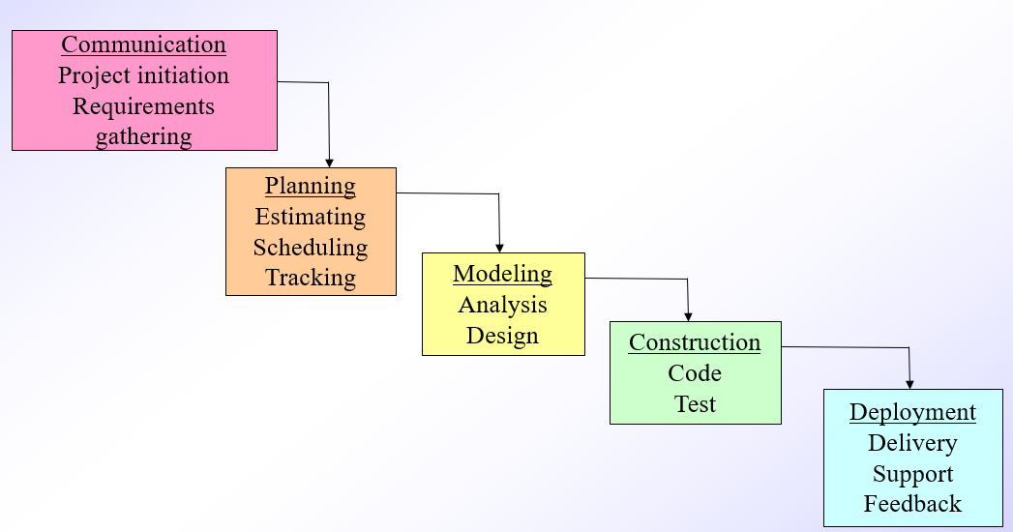
Waterfall Model

Slide 15
Iterative Waterfall Model
The Iterative Waterfall Model is a modified version of the classic Waterfall Model, where feedback loops are added to allow going back and revisiting previous phases when needed.
Unlike the pure waterfall model (which is strictly linear), the iterative version allows corrections — making it more flexible and realistic for software development.

Slide 16
Iterative Waterfall Model
Phases of the Iterative Waterfall Model:
Requirements Analysis
System Design
Implementation (Coding)
Integration & Testing
Deployment (Installation)
Maintenance
Key Feature: At any stage, feedback can lead the team to revisit a previous phase and make changes before proceeding.

Slide 17
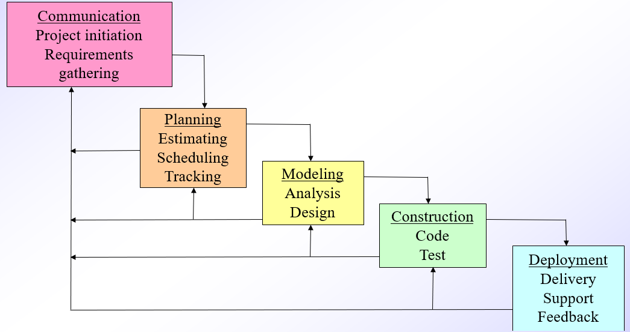
Iterative Waterfall Model

Slide 18
Prototyping Model
Prototyping is discussed in the literature as a separate approach to software development. Prototyping as the name suggests, requires that a working version of the software is built early in the project life. There are two types of prototyping models, namely:
Throw away prototype and
Evolutionary prototype
The objective of the throw away prototyping model is to understand the requirements and solution methodologies better. The essence is speed. Hence, an ad-hoc and quick development approach with no thought to quality, is resorted to. It is akin to 'code and test'. However, once the objective is met, the code is discarded and fresh development is started, ensuring that quality standards are met. Since the requirements are now well understood, one could use the sequential approach. This model suffers from wastage of effort, in the sense that developed code is discarded, because it does not meet the quality standards.

Slide 19
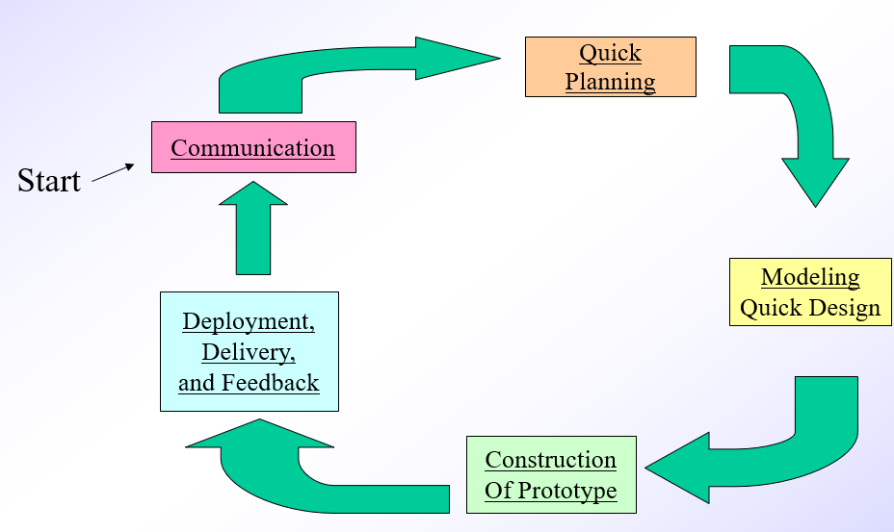
Prototyping Model

Slide 20
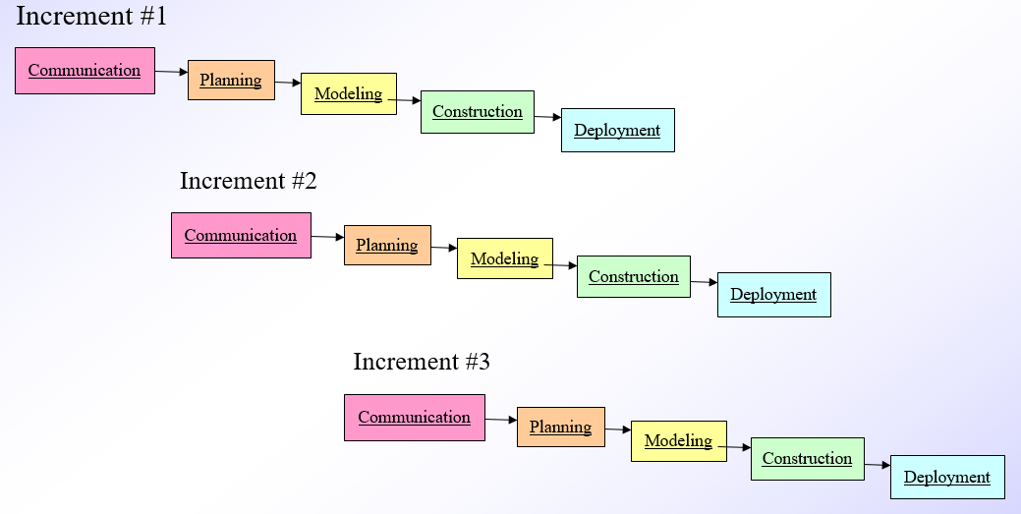
Incremental Model

Slide 21
Prototyping Model
Evolutionary prototyping takes a different approach. The requirements are prioritised and the code is developed for the most important requirements first, always with an eye on quality. Software is continuously refined and expanded with feedback from the client. The chief advantage of prototyping is that the client gets a feel of the product early in the project life cycle.
As can be seen, evolutionary prototyping is an iterative model. Such a model can be characterised by doing a little analysis, design, code, test and repeat the process till the product is complete

Slide 22
Spiral Model
Barry Boehm has suggested another iterative model called the spiral model. It is more in the nature of a framework, which needs to be adapted to specific projects.
It allows best mix of other approaches and focusses on eliminating errors and unattractive alternatives early.
An important feature of this model is the stress on risk analysis. Once the objectives, alternatives, and constraints for a phase are identified, the risks involved in carrying out the phase are evaluated, which is expected to result in a 'go, no go' decision. For evaluation purposes, one could use prototyping, simulations, etc. This model is best suited for projects, which involve new technology development.
Risk analysis expertise is most critical for such projects.

Slide 23
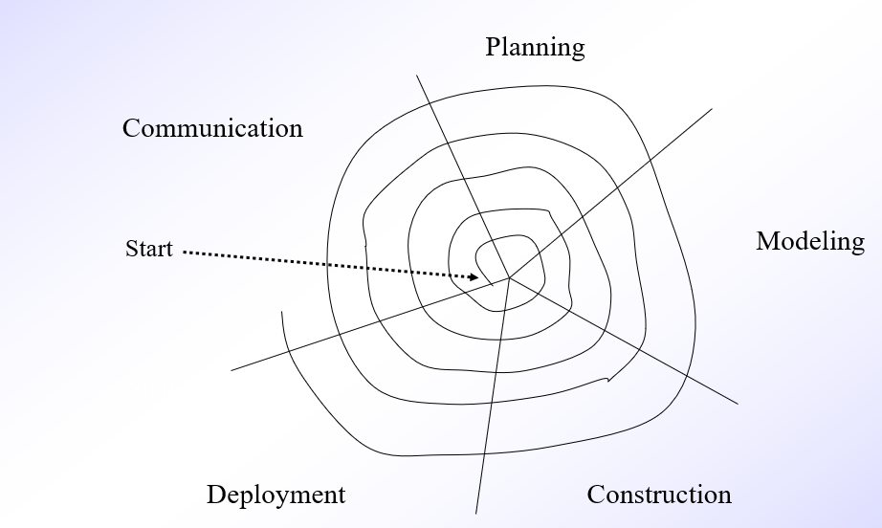
Spiral Model

Slide 24
Spiral Model

Slide 25
Phases of Each Spiral Cycle
Objective Setting
Identify goals, deliverables, and constraints for this iteration.
Define what features or functions will be addressed.
Risk Assessment & Reduction
Identify key risks (technical, cost, schedule, performance).
Perform prototyping, simulations, or analyses to mitigate those risks.
Development & Validation
Design, code, and test the features scoped for this cycle.
Can follow lightweight waterfall, prototyping, or any suitable model.
Planning the Next Iteration
Review progress, update requirements, and plan the next spiral loop.
Estimate costs and timelines for upcoming cycles.

Slide 26
Rapid Application Development Model (RAD)
The RAD model (Rapid Application Development) is a type of software development lifecycle (SDLC) model that emphasizes quick development and iteration through prototyping, user feedback, and reuse of components.
What is the RAD Model?
RAD (Rapid Application Development) is a linear sequential software development process model that emphasizes:
Minimal planning
Rapid prototyping
Early user involvement
Component-based construction
It is ideal for projects where requirements are well understood and changes are expected during development.

Slide 27
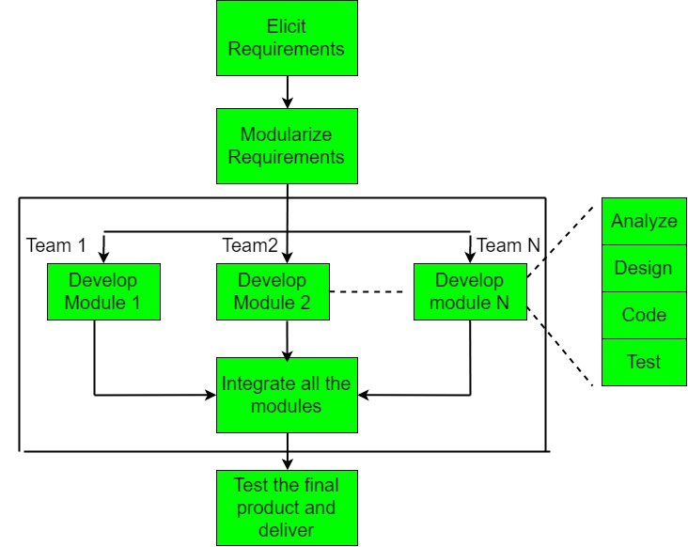
Rapid Application Development Model (RAD)

Slide 28
Rapid Application Development Model (RAD)
Phase | Description
1. Requirements Planning | Stakeholders, developers, and users discuss business needs, project scope, and requirements.
2. User Design | Users and developers work together to create mockups and prototypes. Feedback is collected in real-time.
3. Rapid Construction | Actual development begins. Reusable components and code generators are used to speed up the process.
4. Cutover | Final testing, user training, data conversion, and system implementation happen in this phase.

Slide 29
Rapid Application Development Model (RAD)
Key Characteristics:
Time-boxed delivery
Continuous user feedback
Iterative prototyping
Emphasis on reuse of software components

Slide 30
Rapid Application Development Model (RAD)
When to Use RAD:
When you need fast delivery
When users are available and actively involved
When the project scope is clear
For small to medium-sized projects that require short development cycles

Slide 31
Rapid Application Development Model (RAD)
Disadvantages:
Not suitable for large-scale or complex systems
Requires frequent user interaction
Poor documentation due to fast iterations
Not ideal if technical risk is high

Slide 32
Case study
A student team is developing Gizmoball, a physics-based pinball game that lets users create, simulate, and play custom pinball boards. To ensure structured development, the team selects and applies a suitable SDLC model — Waterfall, Agile, or RAD — based on the project's timeline, complexity, and user feedback needs.

Slide 33
Agile Methodologies
All the methodologies described before are based on the premise that any software development process should be predictable and repeatable. One of the criticisms against these methodologies is that there is more emphasis on following procedures and preparing documentation.
They are considered to be heavyweight or rigorous. They are also criticised for their excessive emphasis on structure. There is a movement called Agile Software Movement, questioning this premise.
The proponents argue that software development being essentially a human activity, there will always have variations in processes and inputs and the model should be flexible enough to handle the variations.
For example: the entire set of software requirements cannot be known at the begining of the project nor do they remain static. If the model cannot handle this dynamism, then there can be lot of wastage of effort or the final product may not meet the customer's needs.
Hence the agile methodolgies advocate the principle "build short, build often". That is the given project is broken up in to subprojects and each subproject is developed and integrated in to the already delivered system.
This way the customer gets continuous delivery of useful and usable systems. The subprojects are chosen so that they have short delivery cycles, usually of the order of 3 to 4 weeks.

Slide 34
Agile Methodologies
The development team also gets continuous feedback. A number of agile methodologies have been proposed. The more popular among them are SCRUM, DYNAMIC SYSTEMS DEVELOPMENT METHOD (DSDM), CRYSTAL METHODS, FEATURE-DRIVEN DEVELOPMENT, LEAN DEVELOPMENT (LD), EXTREME PROGRAMMING (XP).
SCRUM: It is a project management framework. It divides the development in to short cycles called sprint cycles in which a specified set of features are delivered. It advocates daily team meetings for coordination and integration.
DYNAMIC SYSTEMS DEVELOPMENT METHOD (DSDM): It is characterised by nine principles:
1. Active user involvement
2. Team empowerment
3. Frequent delivery of products
4. Fitness for business purpose
5. Iterative and incremental development
6. All changes during development are reversible
7. Baselining of requirements at a high level
8. Integrated testing

Slide 35
Agile Methodologies
CRYSTAL METHODOLOGIES: They are a set of configurable methodologies. They focus on the people aspects of development. The configuration is carried out based on project size, criticality and objectives. Some of the names used for the methodologies are Clear, Yellow, Orange, Orange web, , Red , etc.
FEATURE DRIVEN DEVELOPMENT (FDD): It is a short iteration framework for software development. It focuses on building an object model, build feature list, plan by feature, design by feature, and build by feature.
LEAN DEVELOPMENT (LD): This methodology is derived from the principles of lean production, the restructuring of the Japanese automobile manufacturing industry that occurred in the 1980s. It is based on the following principles of lean thinking: Eliminate waste, Amplify learning, Decide as late as possible, Deliver as fast as possible, Empower the team, Build the integrity in, See the whole.
EXTREME PROGRAMMING (XP): This methodology is probably the most popular among the agile methodologies. It is based on three important principles, viz., test first, continuous refactoring, and pair programming.

Slide 36
CRYSTAL METHODOLOGIES
Name | Team Size | Criticality Level | Typical Use Case
Crystal Clear | 1–6 people | C – Comfort (non-life-threatening) | Internal tools, utilities, small apps
Crystal Yellow | 6–20 people | D – Discretionary money (can lose money) | Medium-sized business apps
Crystal Orange | 20–50 people | E – Essential money (can’t afford to fail) | Large business systems, multi-team projects
Crystal Orange Web | 20–40 web developers | E – Essential money, web-based systems | Large web applications with reliability needs
Crystal Red | 50–100+ people | L – Life (risk to human life) | Aerospace, healthcare, safety-critical systems

Slide 37
FEATURE DRIVEN DEVELOPMENT (FDD):
Activity | Description
Develop an Overall Model | Understand domain and define a high-level object model
Build a Features List | Break system requirements into a list of features
Plan by Feature | Prioritize and schedule feature development
Design by Feature | Small teams design each feature in detail
Build by Feature | Code, test, and integrate each feature individually

Slide 38
Lean Software Development (LSD)
Principle | Description
Eliminate Waste | Remove anything that doesn’t add customer value (e.g., unused code, extra features, delays)
Build Quality In | Prevent defects through good design, code reviews, testing, and automation
Create Knowledge | Learn continuously through feedback, documentation, and prototyping
Defer Commitment | Make decisions at the last responsible moment to stay flexible
Deliver Fast | Use small batches, short iterations, and continuous delivery
Respect People | Empower teams, trust developers, encourage communication
Optimize the Whole | Improve the entire system, not just parts of it; avoid local optimizations

Slide 39
EXTREME PROGRAMMING (XP):
Practice | Description
Pair Programming | Two developers work together at one workstation – one writes code, the other reviews it in real-time.
Test-Driven Development (TDD) | Write automated tests before writing the code itself.
Continuous Integration | Code is integrated and tested frequently (multiple times a day).
Refactoring | Improve code structure without changing its behavior to keep it clean and maintainable.
Small Releases | Deliver working software frequently in small, incremental releases.
Collective Code Ownership | Any team member can modify any part of the code at any time.
Sustainable Pace | Avoid overworking – aim for a consistent 40-hour workweek to maintain long-term productivity.
On-site Customer | A real customer is available full-time to answer questions and set priorities.

Slide 40
Kanban – Agile Methodology
Kanban is an Agile methodology used to visualize work, limit work in progress (WIP), and improve workflow efficiency.
It helps teams manage tasks by showing the status of each item in a visual board (usually with columns like "To Do", "In Progress", "Done").

Slide 41
Kanban – Agile Methodology
Key Principles of Kanban
Visualize the Workflow Use a board to make tasks and progress transparent to everyone.
Limit Work in Progress (WIP) Set a maximum number of tasks per stage to avoid overload and context switching.
Manage Flow Monitor how work moves through the system and identify bottlenecks.
Make Process Policies Explicit Define rules for how work moves through each stage.
Implement Feedback Loops Regular meetings (daily stand-ups, reviews) help teams improve.
Improve Collaboratively, Evolve Experimentally Use data to continuously improve the process.

Slide 42
Kanban – Agile Methodology
Key Metrics in Kanban
Lead Time: Time from task creation to completion
Cycle Time: Time from task start to completion
Throughput: Number of tasks completed in a period
WIP: Number of tasks in progress
Tools That Support Kanban
Trello
Jira
Asana
ClickUp
Azure DevOps

Slide 43
Kanban vs Scrum (Quick Comparison)
Feature | Kanban | Scrum
Time-boxed | No (continuous flow) | Yes (2–4 week sprints)
Roles | No specific roles required | Scrum Master, Product Owner
Planning | Ongoing | Planned at the start of sprint
Metrics | Cycle time, Lead time | Velocity, Burndown charts
Flexibility | Highly flexible | Structured iteration model

Slide 44
How It Works:
| To Do | In Progress (WIP Limit: 3) | Testing | Done |
Why Limit WIP?
Avoids multitasking overload
Reduces stress and bottlenecks
Improves focus and task completion speed
Minimizes delays and wait times
Increases overall efficiency and flow

Slide 45
How to choose a process?
Among the plethora of available processes, how can we choose one? There is no single answer to this question. Probably the best way to attack this problem is to look at the software requirements.
If they are stable and well understood, then waterfall model may be sufficient.
If they are stable, but not clear, then throw away prototyping can be used.
Where the requirements are changing, evolutionary prototyping is better.
If the requirements are coupled with the underlying business processes, which are going through a process of change, then a model based on Boehm's spiral model, like the Rational Unified Process should be used.
In these days of dynamic business environment, where 'time to market' is critical, and project size is relatively small, an agile process should be chosen.
These are but guidelines only. Many organizations choose a model and adapt it to their business requirements. For example, some organizations use waterfall model, modified to include iterations within phases.

